Slide 1
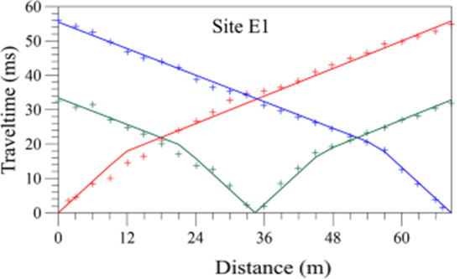
Exercise-3
Consider the following travel-time plots of 3 shot gathers.
a) Determine velocity and thickness of layers in each source point.
b) Explain your idea about the dip of layer.
Prepare Presentation to illustrate your work.

